Slide 1

2026 Truth in taxation
December 2, 2025

Slide 2
Truth in taxation – purpose of meeting
Overview of City’s budget development process
Provide more detail on the Proposed 2026 Levy
Estimated City property tax impact
Answer questions

Slide 3
Strategies of Long-term focus
Deliver exceptional public service
Foster engaged, informed and involved citizens and community
BE Fiscally responsible as a city
Comply with bond requirements – approximately 5.4% of tax levy is used to make bond payments
Become a debt free city

Slide 4
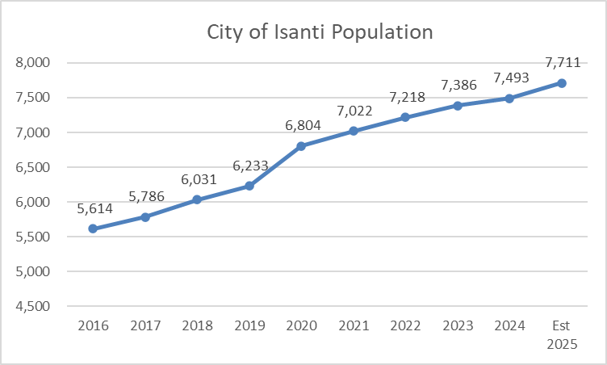
10 year trend of population growth

Slide 5
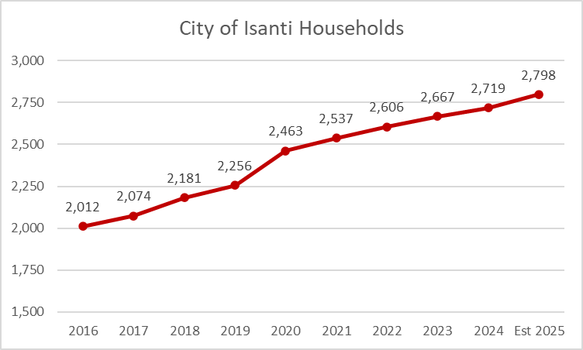
10 year trend of number of households

Slide 6
Proposed use of 2026 taxes
Keep the public safe
Keep the public moving
Encourage sustainable recreation
Keep the city compliant with laws and be fiscally responsible

Slide 7
Keep the public safe
Current Staffing:
10 sworn officers
2 support staff – of which one is vacant
1 community service officer
3 volunteer reserve officers
Building inspection provided by rum river consultants

Slide 8
Keep the public moving
For 2025 The city maintained:
60 Miles of streets
32 Miles of trails and sidewalks (plow 30 miles)
8 public works employees and 3 seasonal employees
2026 budget includes additional equipment for our in-house mechanic to be able to service more city vehicles

Slide 9
Encourage parks and recreation
The city has 4 park shelters along with amphitheater, ballfield, tennis courts, basketball courts, volleyball court, and other facilities available for reservation
City puts on street dances, splish splash summer bash, family summer entertainment series, jubilee days parade, and fireworks display
Supported by parks & recreation coordinator
supported by public works employees

Slide 10
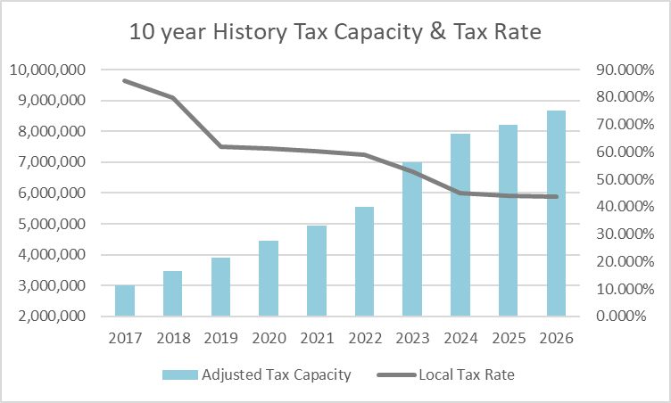
Keep the city compliant with laws and be fiscally responsible
continue to utilize the expert-knowledge base both internal and external
Annual audit performed of financials to comply with laws
Continuing funding capital funds for future projects
Working towards lowering tax levy rate while avoiding future tax levy rate spikes

Slide 11
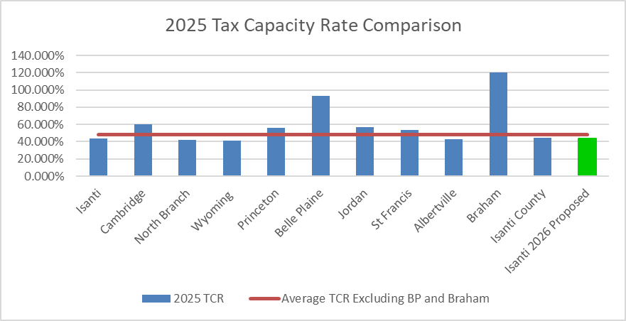
2025 Tax Rate Comparison

Slide 12
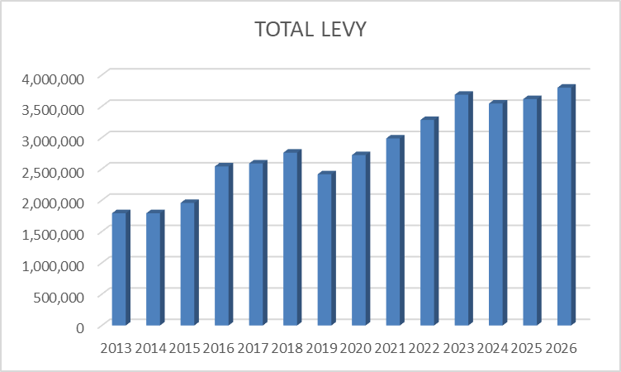
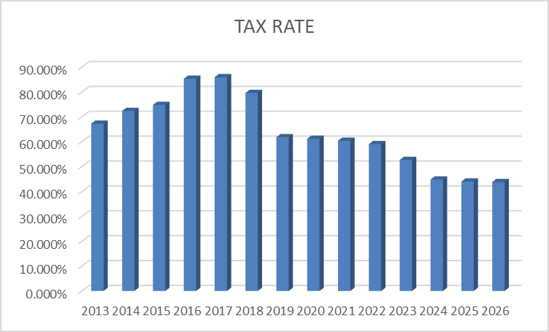
City Tax levy 2026

Slide 13
individual tax impact

Slide 14
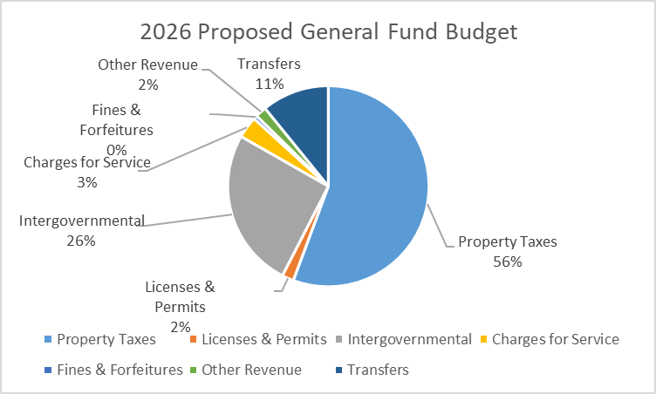
General Fund Revenue summary

Slide 15
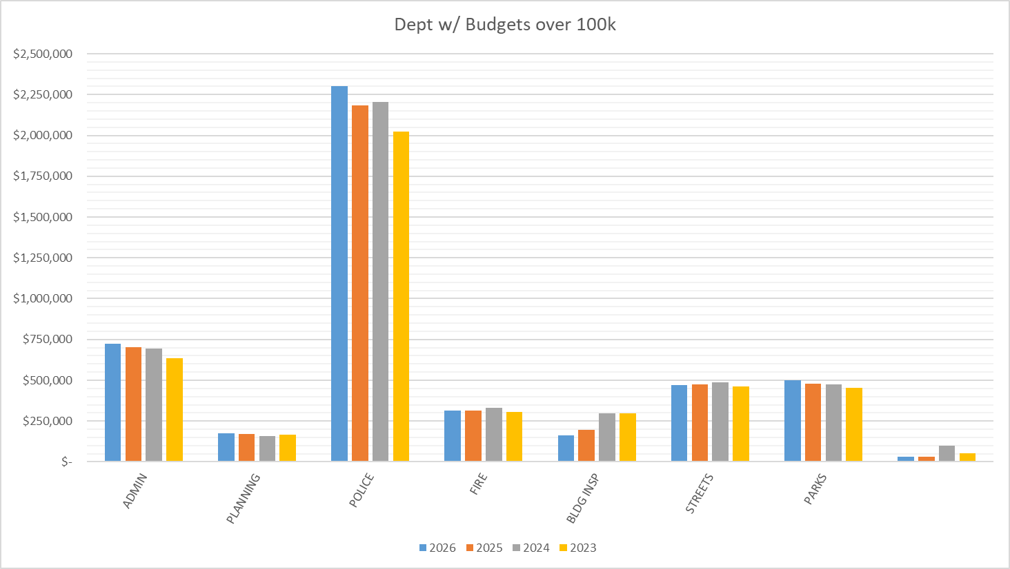
General Fund Expenditure summary

Slide 16
Budget by Department including cip

Slide 17
Property value is too high?
For taxes payable in 2026, your value is already set
For taxes payable in 2027:
  Contact the Isanti County Assessor’s Office at 763-689-2752, be prepared to schedule an onsite visit at your property
  If you still disagree with your property’s value, you may appear before the local Board of Appeal and Equalization in the Spring of 2026
Property Tax Programs available from State of Minnesota
  https://www.revenue.state.mn.us/property-tax-programs

